Slide 1

Sri Balaji University, Pune “Online Library Management System”
Project Guide:-
Prof. Rajasmita Panda
Presented By:-
Nitin Yadav (MCA2302015)
Shyam Thakkar (MCA2302036)
Tanmay Hande (MCA2302094)

Slide 2

Abstract
This system proves to be a significant improvement over the traditional manual processes.
Library staff can manage book inventories, track user transactions, and maintain records efficiently.
The system benefits educational institutions, public libraries, and organizations that aim to provide.
The primary aim of the project is to replace the existing manual system with an automated solution that leverages computerized tools to store, retrieve, and manage valuable data for longer period

Slide 3

Purpose & Scope
This system simplifies library operations and provides a structured and secure environment where both users and librarians can interact with ease.
The purpose is to offer a solution that allows quick access to information and promotes efficient handling of library resources.
The platform also ensures transparency by keeping track of every transaction, making it easier for users to access and manage their accounts and book loans.
The scope includes developing a user-friendly interface for both library staff and users, ensuring easy navigation and functionality.

Slide 4
Languages Used
Front-End Languages
HTML(Hyper Text Markup Language):- Helps Defines the structure of web page
CSS(Cascading Style Sheet):- Helps to style, the appearance of web page
JS(JavaScript):- Helps to add interactive functionality to the web page
Back-End Languages
1)Php (Hyper Text Pre-Processor):- Serverside scripting language used for dynamic web content
2) MySQL (Relational Database):- A relational database management system used to store and organize data in table format

Slide 5
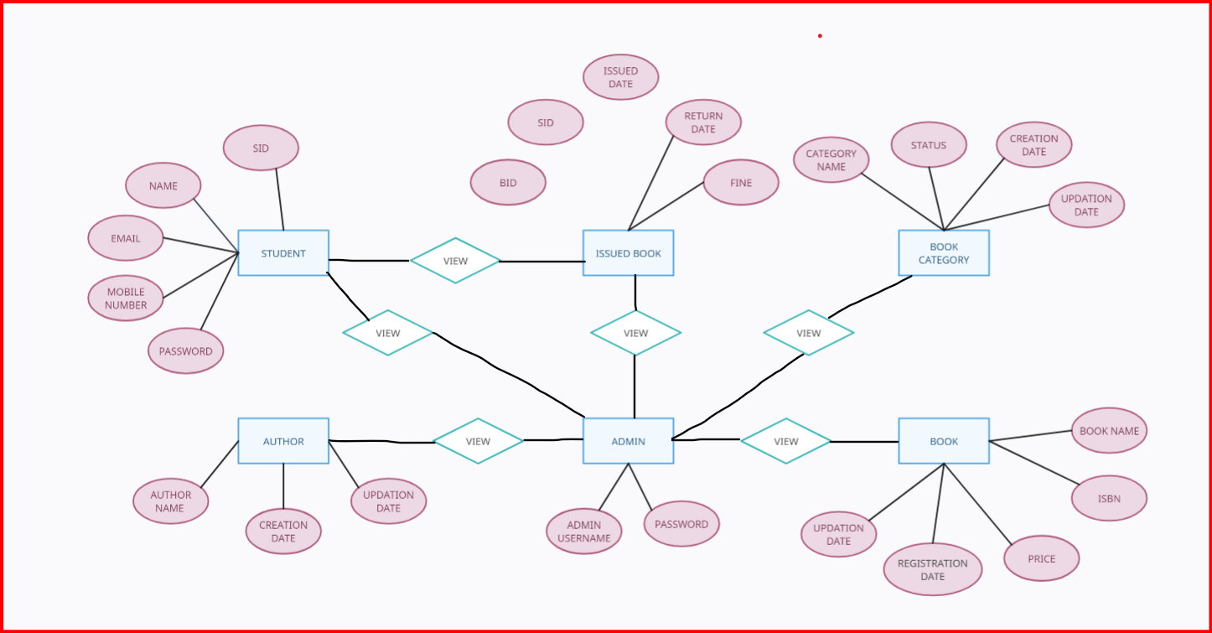
System Diagram
Entity-RelationShip Diagram

Slide 6
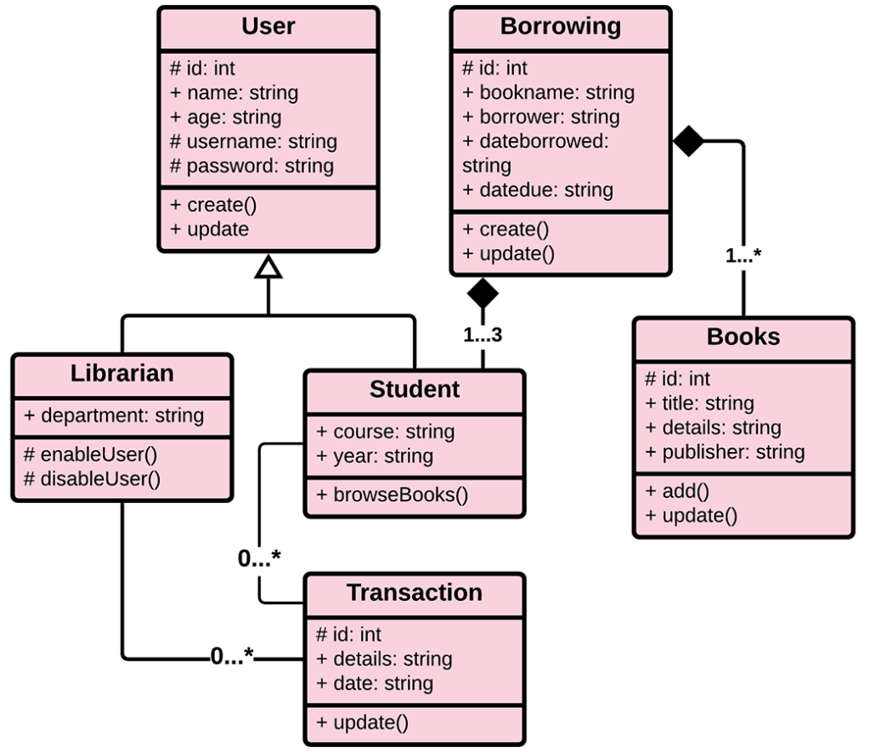
System Diagram
Entity-RelationShip Diagram

Slide 7
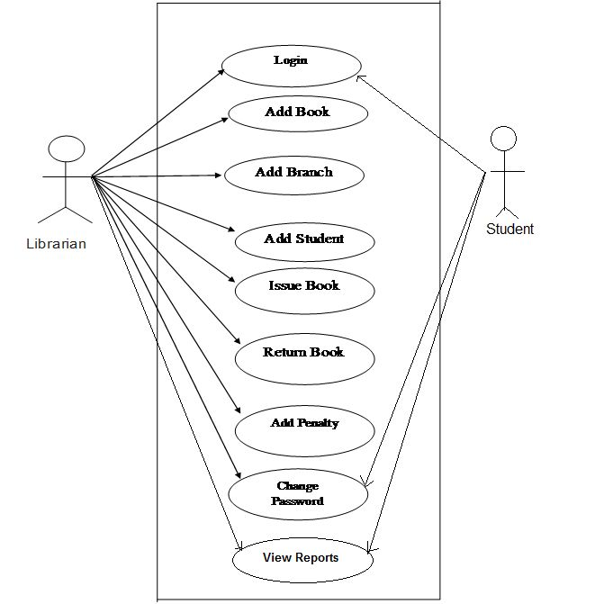
System Diagram
Activity Diagram

Slide 8
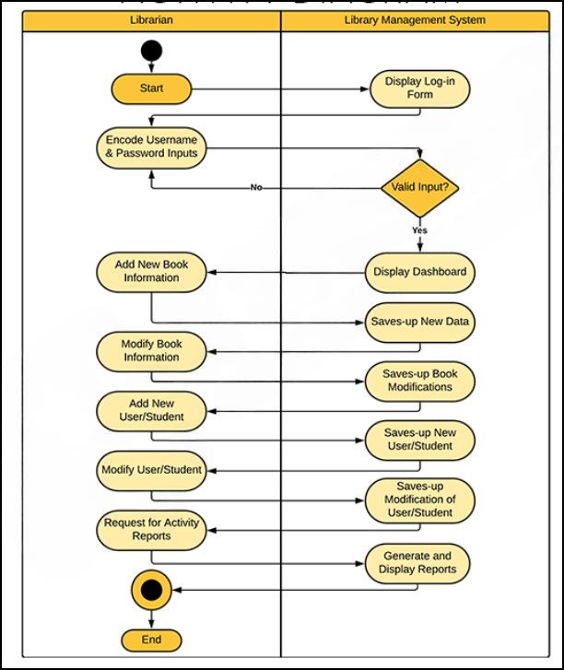
System Diagram
Activity Diagram

Slide 9
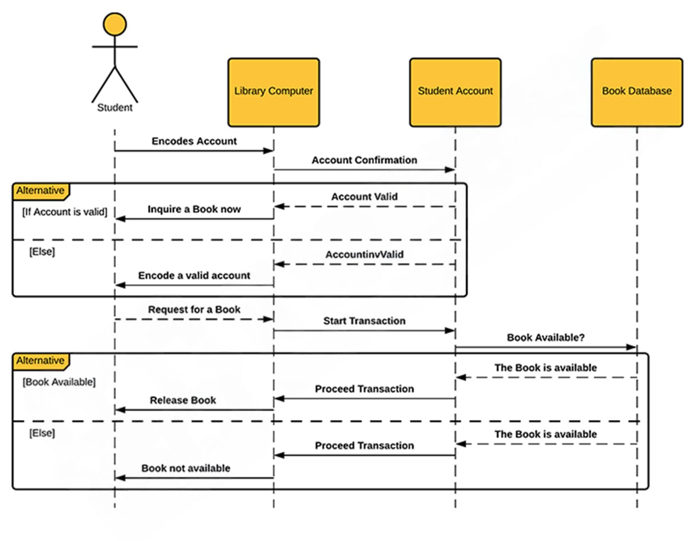
System Diagram
Sequence Diagram

Slide 10
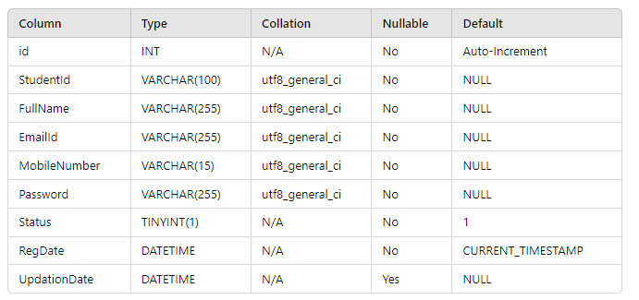
Data Model
1) Student Table

Slide 11
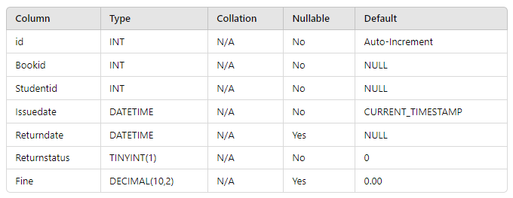
Data Model
2)Issued Book Table

Slide 12
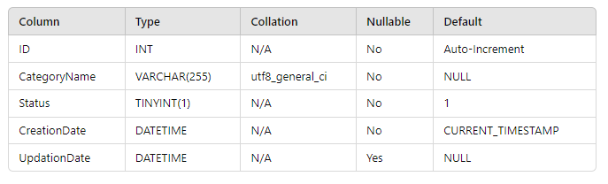
Data Model
3) Category Table

Slide 13
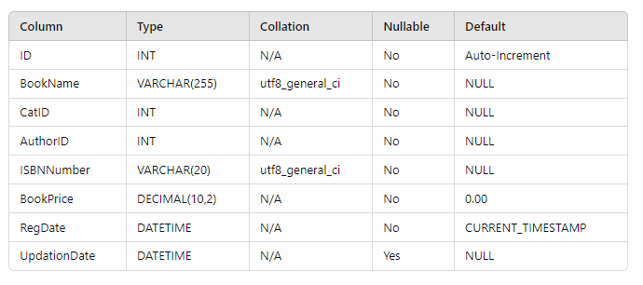
Data Model
4) Book Table

Slide 14
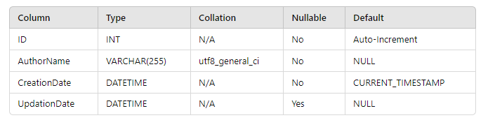
Data Model
5) Author Table

Slide 15
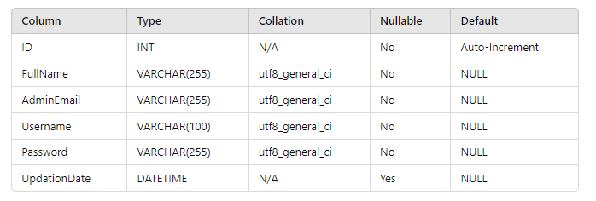
Data Model
6) Admin Table

Slide 16
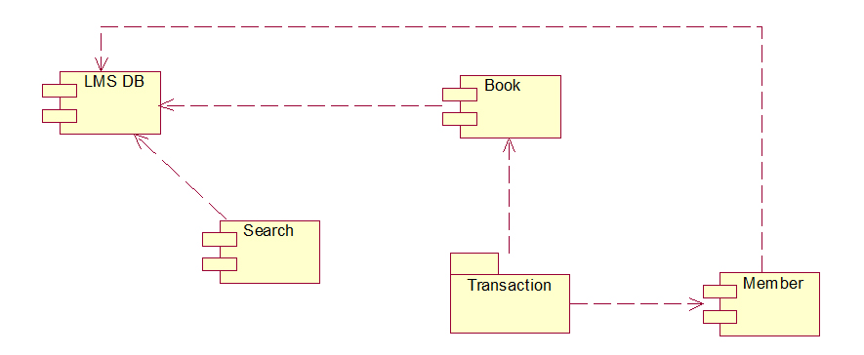
System Diagram
Deployment Diagram

Slide 17
Modules in Project
User Modules
1) Issued Book
2) Account Handling
Admin Modules
Book Category
Book Author
Books
Issue Book
Registered Student
Account Handling

Slide 18
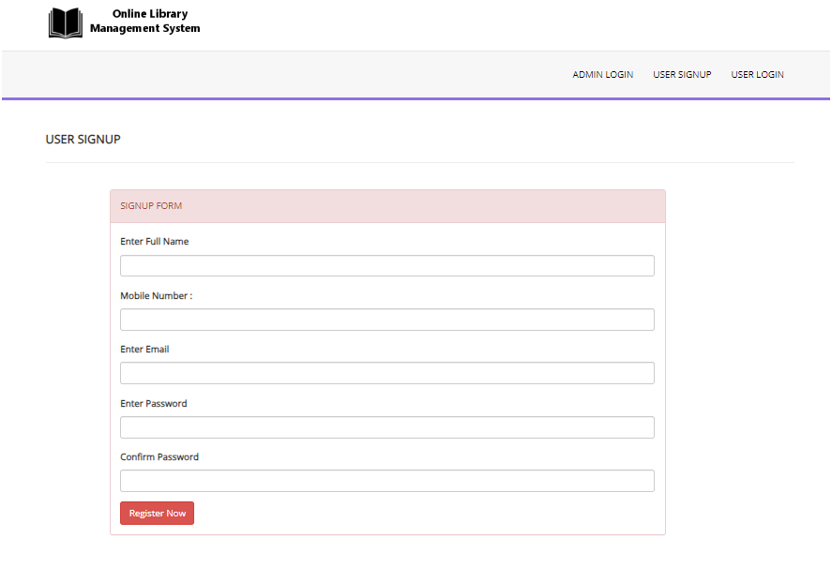
User Interface
User Registration Form

Slide 19
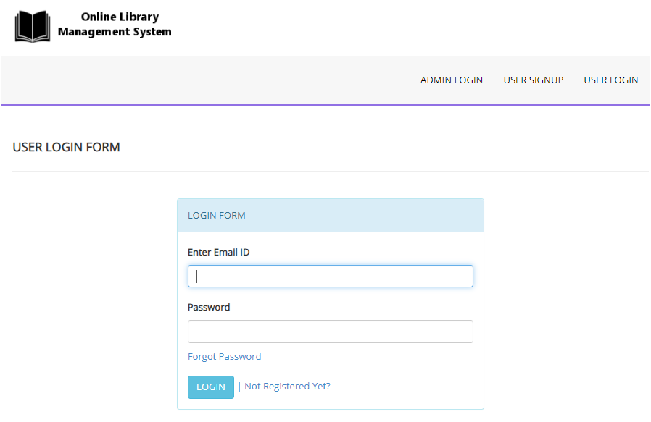
User Interface
User Login Form

Slide 20
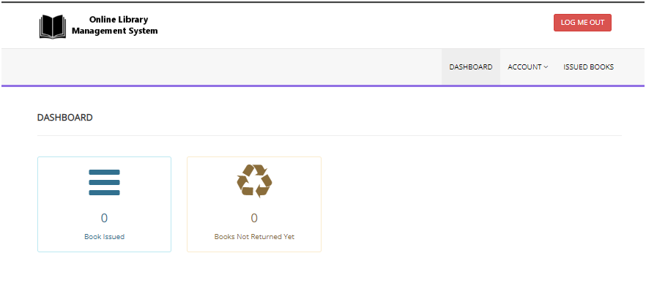
User Interface
User Dashboard Page

Slide 21
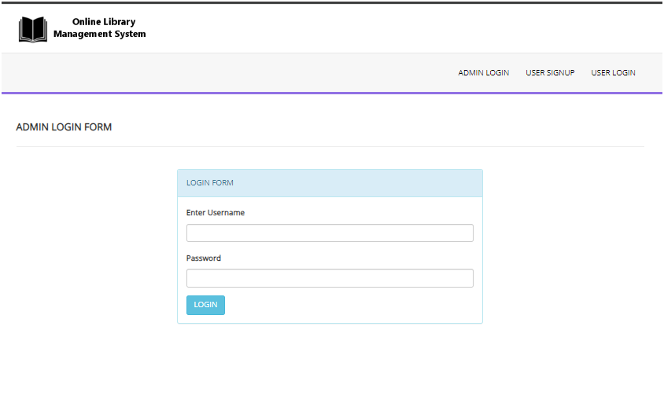
User Interface
Admin Login Form

Slide 22
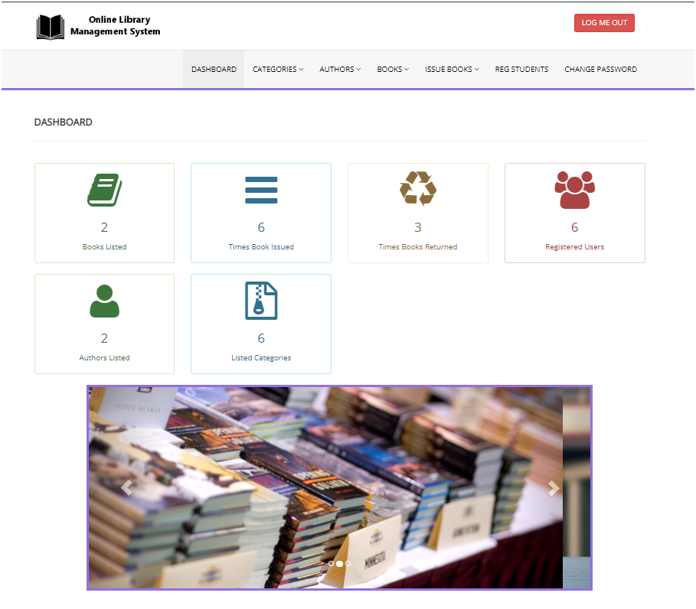
User Interface
Admin Dashboard Page

Slide 23

Future Scope
To enhance “ONLINE LIBRARY MANAGEMENT SYSTEM," several improvements can be implemented:
1. Two-Factor Authentication
2. Feedback System
3. Automated Reporting
4. Payment System for Fine Payoff

Slide 24
Conclusion
A library management system is a valuable tool for libraries of all sizes. It automates tasks, improves accuracy, enhances accessibility, and provides data for better decision-making. By choosing the right system, providing training, and maintaining it regularly, libraries can reap the benefits of improved efficiency and cost savings

